Slide 1
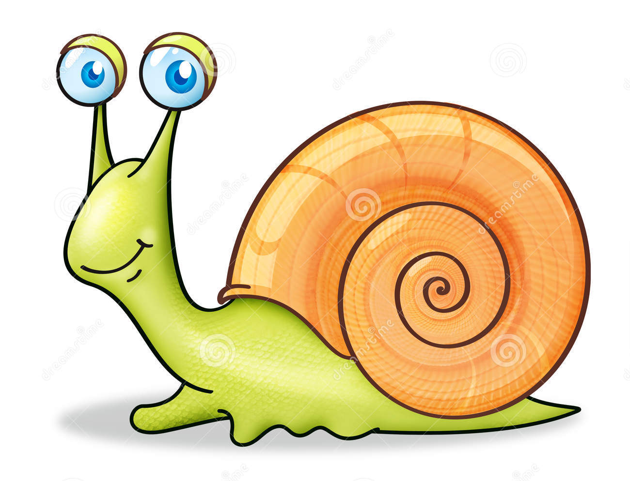
Slow Poke Evolution Poster
A population of “Slow Pokes” has lived on a large island called Slugland in the middle of the ocean for thousands of years. After a period of undersea volcanic activity 4 new islands appeared. Over time the original Slow Poke population moved to inhabit these 4 new islands.

Slide 2
Slugland & Island Set Up
Title your Poster “Mechanisms of Evolution”
Write your name underneath the title
On your sheet of paper draw a large central island with your starting organism illustrated and named on it. You may choose to use Slow Poke or an organism of your own creation.

Slide 3
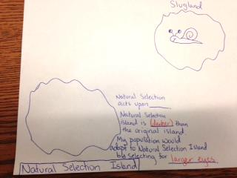
Natural Selection Island
What does Natural Selection act upon?
Natural Selection acts upon adaptations
What is different in the environment of Natural Selection Island than the environment of the original island? (Is it hotter? Colder? Drier? Etc.)
Natural Selection island is ________ than the original island.
How might your organism look different over time?
My population would adapt to Natural Selection Island by _______.
Will this eventually result in speciation?
Speciation: Yes/No

Slide 4
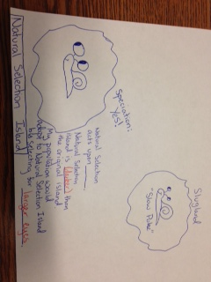
Draw your adapted organism on Natural Selection Island

Slide 5
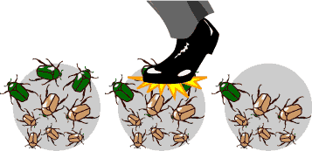
a. Genetic Drift
A random change in the frequency of alleles in small populations often due to natural disasters
Examples of Genetic Drift
Bottleneck Effect
Founder Effect

Slide 6
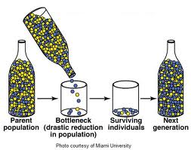
Bottleneck Effect
A form of genetic drift that occurs when a population’s size is reduced for at least one generation.

Slide 8
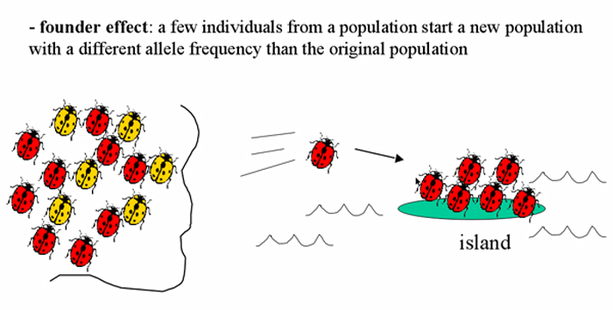
Founders Effect
A few individuals from a population start a new population with a different allele frequency than the original population.

Slide 9
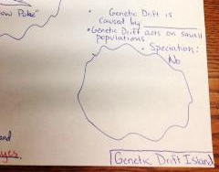
Genetic Drift Island
What causes Genetic Drift?
Genetic drift is caused by random events such as _____________.
What must happen to the size of the population for genetic drift to occur?
Genetic drift acts upon small populations
Does this cause speciation to occur?
Speciation: Yes/No

Slide 10
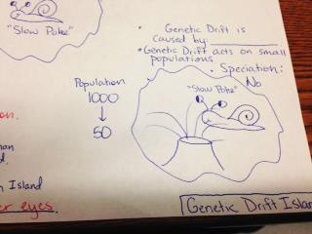
Draw your organism on Genetic Drift Island
As well as a picture that represents the event that could cause Genetic Drift (ie a volcanic eruption)

Slide 11
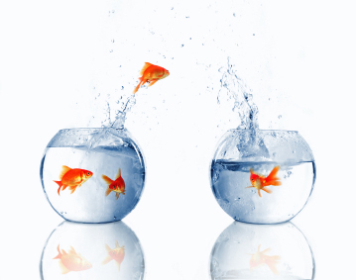
Gene Flow: Migration
Introduction of new alleles in a population. New individuals enter a population and contribute to the gene pool.

Slide 12
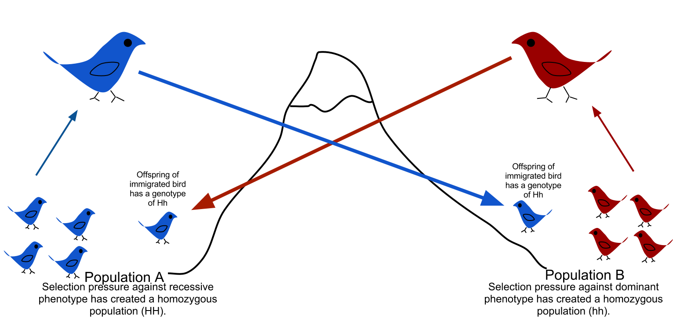
Gene Flow prevents Speciation

Slide 13
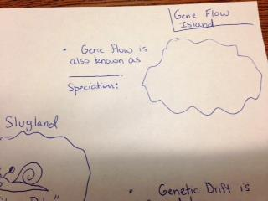
Gene Flow Island
What is another word for Gene Flow?
Gene flow is also known as _________.
Does this allow speciation to occur?
Speciation: Yes/No

Slide 14
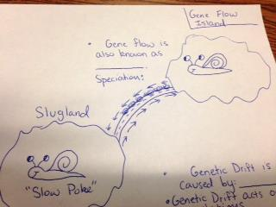
Draw your organism on Gene Flow Island
Draw a bridge between your original island and Gene Flow Island with arrows pointing in both directions.

Slide 15
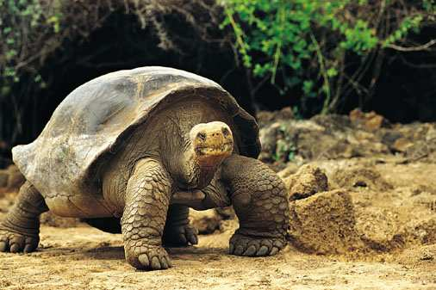
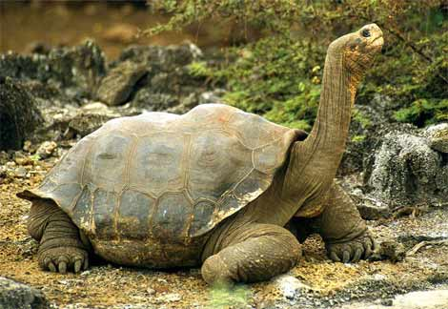
SPECIATION
The formation of a new species
Population must become reproductively isolated for new species to evolve.
SPECIES
Similar physical and genetic characteristics
able to produce fertile offspring

Slide 16
How do species become reproductively isolated?
A. Geographic isolation
A population becomes physically separated from each other and evolve separately due to their environment and their variations. Ex: a canyon, large body of water, islands

Slide 17
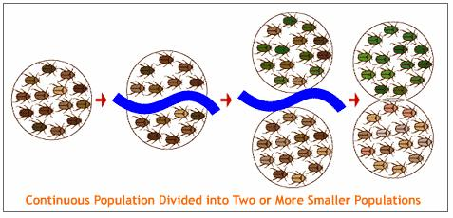

Slide 18
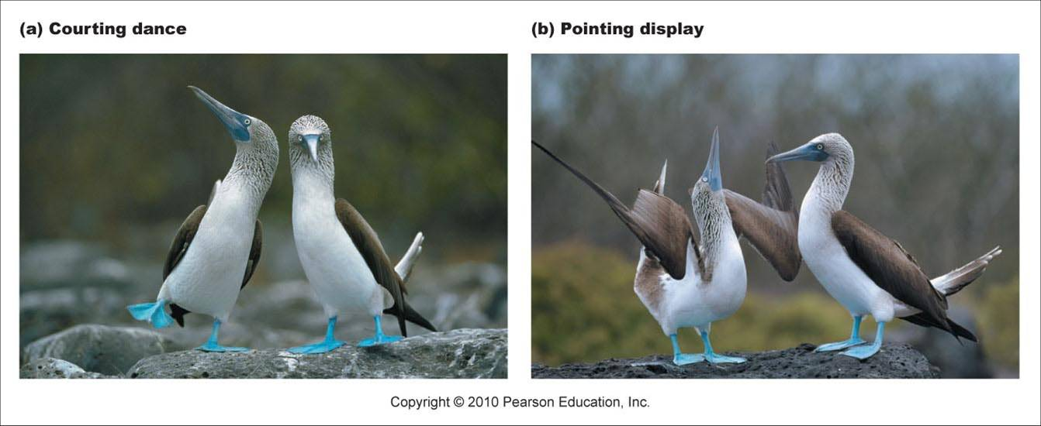
B. Behavioral isolation
two populations have differences in courtship rituals or other types of behavior that prevent them from interbreeding.
Albatross Mating Dance

Slide 19
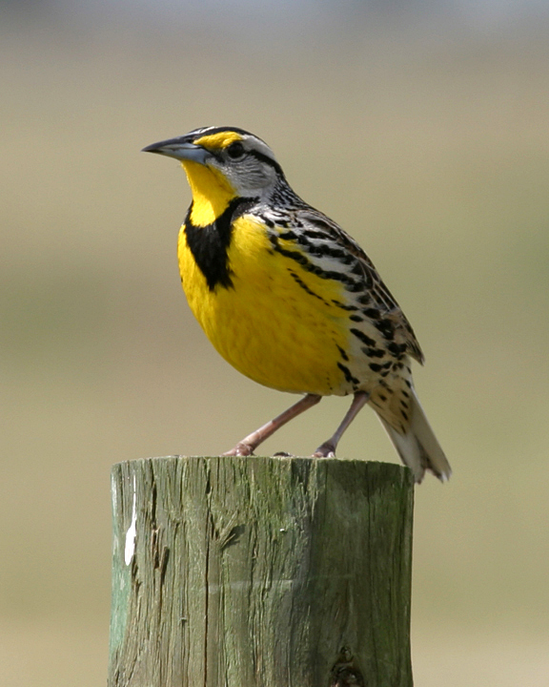
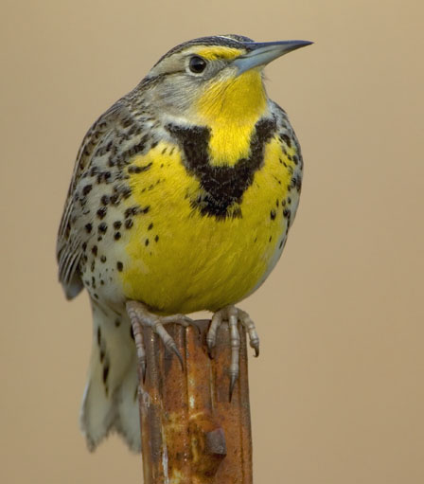
Behavioral Example: Meadowlarks
CAPABLE OF BREEDING BUT HAVE DIFFERENCES IN COURTSHIP RITUALS
Notes:
Prezygotic Behavioral

Slide 20
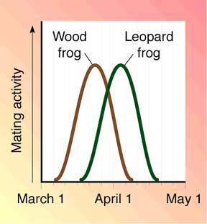
C. Temporal isolation
two populations reproduce at different times.

Slide 21
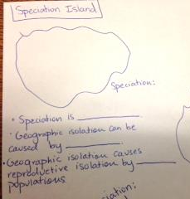
Speciation Island
What is speciation?
Speciation is ________________.
What type of features can cause geographic isolation?
How does geographic isolation cause reproductive isolation?
Geographic isolation causes reproductive isolation by _____.

Slide 22
Evolution on Speciation Island
Down the middle of speciation island draw a feature of your choice that causes geographic isolation. On each side of your island draw the two new descendants of Slow Poke.

Slide 23
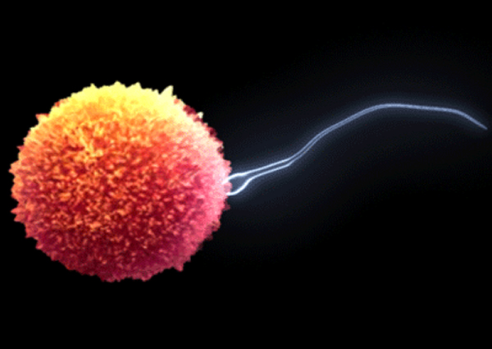
c. Mutation
A change in a DNA sequence that affects genetic expression.
Mutations only contribute to genetic variation if they occur in the DNA sequence found in gametes.

Slide 24
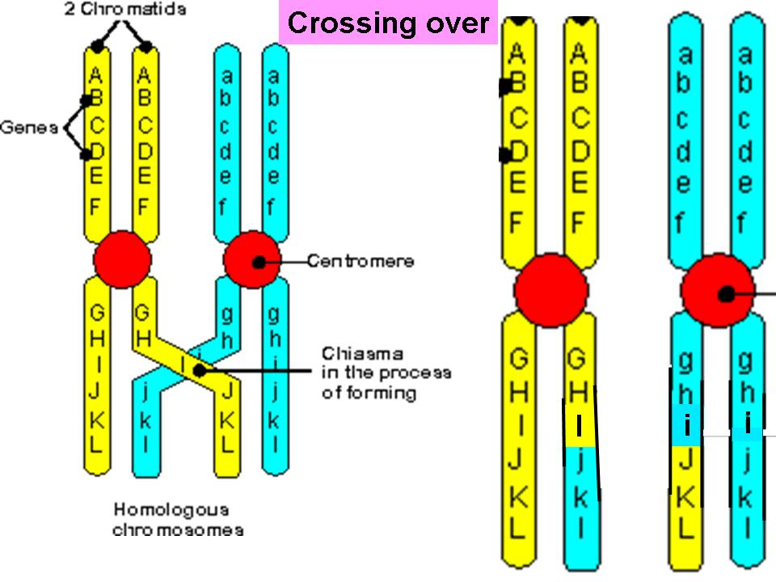
d. DNA Recombination
The process by which genetic material is broken and joined to other genetic material in meiosis and leads to genetic variation (ie crossing over)

